Slide 1
InsightHub
AI-Powered Data & Analytics — for businesses with no data team
From upload to governed, AI-driven insight in under a minute — and it stays current, watches itself, and speaks your industry.
1-click
<60s
24/7
ingest → transform → model → insight
time to first insight
proactive alerts, no one asking
Presales & Go-To-Market Playbook · v1.0 · July 2026
Notes:
Opening: InsightHub turns one-off AI analysis into a durable, governed, proactive analytics system for SMBs who cannot hire a data team. Lead with the outcome, not the tech.

Slide 2
THE PROBLEM
SMBs are data-rich but insight-poor
!
No data team
!
Spreadsheet sprawl
!
One-time AI
The tools that give real analytics (Power BI, Tableau) need a developer to connect sources, build ETL, model data, and design dashboards. SMBs don't have that person.
Numbers live in a dozen exports — POS, e-commerce, accounting. Nobody has a single, current view, and reconciling them by hand eats hours every week.
Pasting a file into ChatGPT gives a brilliant answer once — then it's gone. Next week you re-export, re-upload, re-explain your business from scratch. Nothing persists.
The result: decisions made on gut feel, stale numbers, or a report that's already a week old.
InsightHub · Presales & GTM · Confidential
2
Notes:
Anchor the pain: SMBs have the data but not the team. Existing options are either build-it-yourself or one-time. This is the wedge.

Slide 3
WHY NOW
The market leaves a gap in the middle
Power BI / Tableau
ChatGPT / Claude
InsightHub
BUILD-IT-YOURSELF
ONE-TIME & UNGOVERNED
THE MISSING MIDDLE
Powerful, but a project. You supply the developer, the ETL, the model, the dashboards. Days to weeks before value.
Fantastic first answer — but ephemeral, single-user, no persistence, no governance, no proactivity. Resets every session.
The analytics engineering pipeline as a one-click product — plus persistence, governance, and proactive alerts. Value in minutes, durable forever.
InsightHub does everything Power BI's developer does — automatically — and everything ChatGPT can't: remember, govern, and warn.
InsightHub · Presales & GTM · Confidential
3
Notes:
Frame the category. We are not a cheaper Power BI or a wrapper on ChatGPT — we occupy the missing middle: automated pipeline + durable, governed system.

Slide 4
WHAT INSIGHTHUB IS
One platform. The whole pipeline. One click.
1
2
3
4
5
6
→
→
→
→
→
Ingest
Detect
Transform
Model
Analyze
Act
Upload or connect
Auto domain match
Domain-aware ETL
Star-schema warehouse
Domain KPIs + AI
Alerts + mobile
Power BI / Tableau: a developer does steps 1–4 before anyone sees a chart.
ChatGPT: does step 5 once, then forgets.
InsightHub: does all six, automatically, and keeps doing them.
InsightHub · Presales & GTM · Confidential
4
Notes:
This is the demo spine. Walk the six steps. Emphasize that 1-4 are invisible and automatic — the magic is that the customer never sees the plumbing.

Slide 5
THE DIFFERENTIATOR
Why this is a moat, not a feature
Frontier AI will keep getting better at one-time analysis. We don't compete there — we compete on the system around it.
Persistence
Governance
Every load accumulates in the warehouse. This month sits beside last month automatically. A chat window starts from zero every time.
Multi-tenant RBAC, row/column restriction by role, audit, lineage, GDPR/CCPA. A chat thread is one person with no controls.
Proactivity
Domain-tuning
Threshold + anomaly alerts fire on their own to email/SMS/WhatsApp/Slack. Nobody has to remember to ask the right question.
Pharmacy, SaaS, retail, accounting — the first answer is already tuned to the business, not a blank slate you re-teach each time.
Positioning line: "The operational layer that turns one-off AI brilliance into a recurring, governed habit."
InsightHub · Presales & GTM · Confidential
5
Notes:
CRITICAL slide for sales. If a prospect says 'why not just use ChatGPT?', this is the answer. Never argue AI quality — argue persistence, governance, proactivity, domain-tuning.

Slide 6
CAPABILITIES
What's in the box
●
●
●
●
Auto ingest
Domain detection
Automated ETL
Domain analytics
Excel/CSV upload, scheduled connectors, ERP file-drop
Auto-recognizes the business type from your columns
Cleans, transforms & models on every load — no setup
KPIs, trends, cash flow, cohorts in your industry's language
●
●
●
●
AI insights
Proactive alerts
Ad hoc playground
Governance & RBAC
Plain-language narrative + ask-anything Q&A, grounded in your data
Threshold + anomaly to email, SMS, WhatsApp, Slack
Any dataset that fits no domain still gets full analysis
Tenant isolation, role-based access, audit, GDPR/CCPA
InsightHub · Presales & GTM · Confidential
6
Notes:
Feature checklist — but keep tying each to an outcome. Most of these already exist in the product today, which is a strong proof point.

Slide 7
DOMAIN-ADAPTIVE
The same platform, fluent in every business
Pharmacy
SaaS
Retail / E-comm
Accounting
Generic / Ad hoc
Sales, margin, expiry, GST/tax, stock
MRR, ARR, churn, customers
Orders, AOV, inventory, returns
P&L, cash flow, expenses
Revenue, cost, margin, any table
Auto-detection today, expandable tomorrow. When many customers upload the same new shape, we codify it as a first-class domain — the ad hoc playground is also our domain-discovery funnel.
InsightHub · Presales & GTM · Confidential
7
Notes:
Domain adaptivity is a real, demonstrable differentiator and already built for 5 domains. It lets one product serve many verticals without rebuild.

Slide 8
COMPETITIVE LANDSCAPE
Where we win
Power BI / Tableau
Zoho / Supaboard
ChatGPT / Julius
InsightHub
Zero-setup pipeline
No
Partial
N/A
Yes
Persistent history
Yes*
Yes
No
Yes
Domain auto-tuning
No
No
No
Yes
Proactive alerts
Limited
Some
No
Yes
Governance / RBAC
Enterprise
Yes
No
Built-in
Built for no-data-team SMB
No
Partial
Yes
Yes
Time to first insight
Days
Hours
Minutes*
Minutes
* Only if a developer builds it (Power BI) or within a single session (ChatGPT/Julius).
InsightHub · Presales & GTM · Confidential
8
Notes:
Use this to handle 'how are you different from X'. Our unique columns are domain auto-tuning and zero-setup pipeline for the no-data-team SMB.

Slide 9
FOR THE PRESALES TEAM
The 8-minute demo script
0:00
Set the scene
"You run a business, not a data team. Watch this." Have a messy Excel/CSV ready (their industry if possible).
1:00
Upload
Drag the file in. Point out: no mapping, no setup, no ETL config. It just starts.
2:00
Auto-detection
Show it recognizing the domain and confirming the model. "It already knows this is a retail file."
3:30
Instant analytics
Land on the dashboard — domain KPIs, trends, cash flow, in their currency. "That took 90 seconds."
5:00
Ask the AI
Type a plain-language question. Show grounded, tenant-scoped answer. Contrast: "and this remembers, unlike ChatGPT."
6:30
Proactive alert
Show an anomaly flag / alert config. "It watches your numbers so you don't have to."
7:30
Close
"Upload today, insight today, and it stays current forever. What would you point it at first?"
InsightHub · Presales & GTM · Confidential
9
Notes:
This is the repeatable demo. The emotional beats: no setup (surprise), 90 seconds (speed), it remembers (vs ChatGPT), it watches (proactivity). Always end with a forward question.

Slide 10
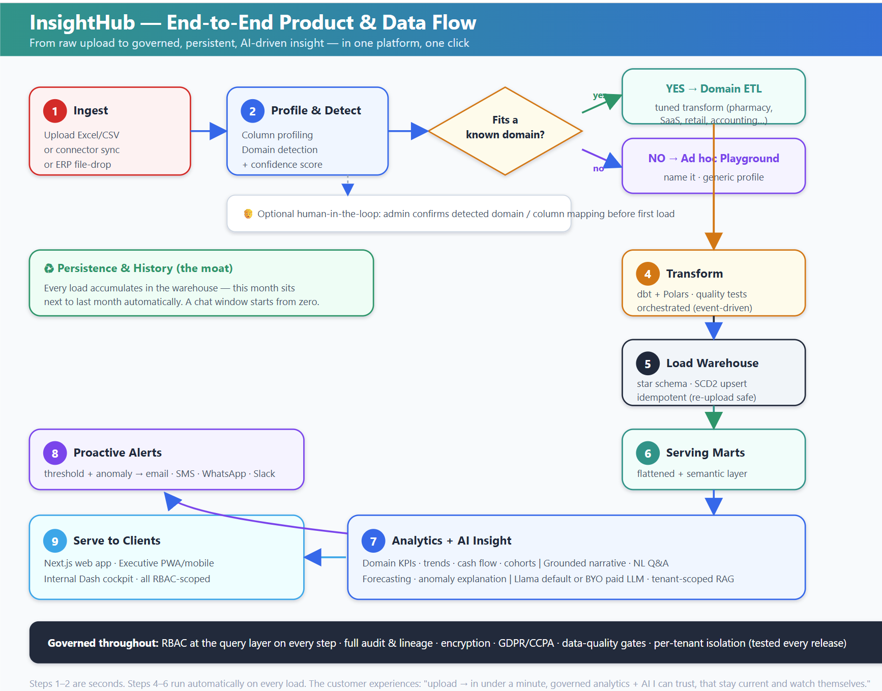

Slide 11
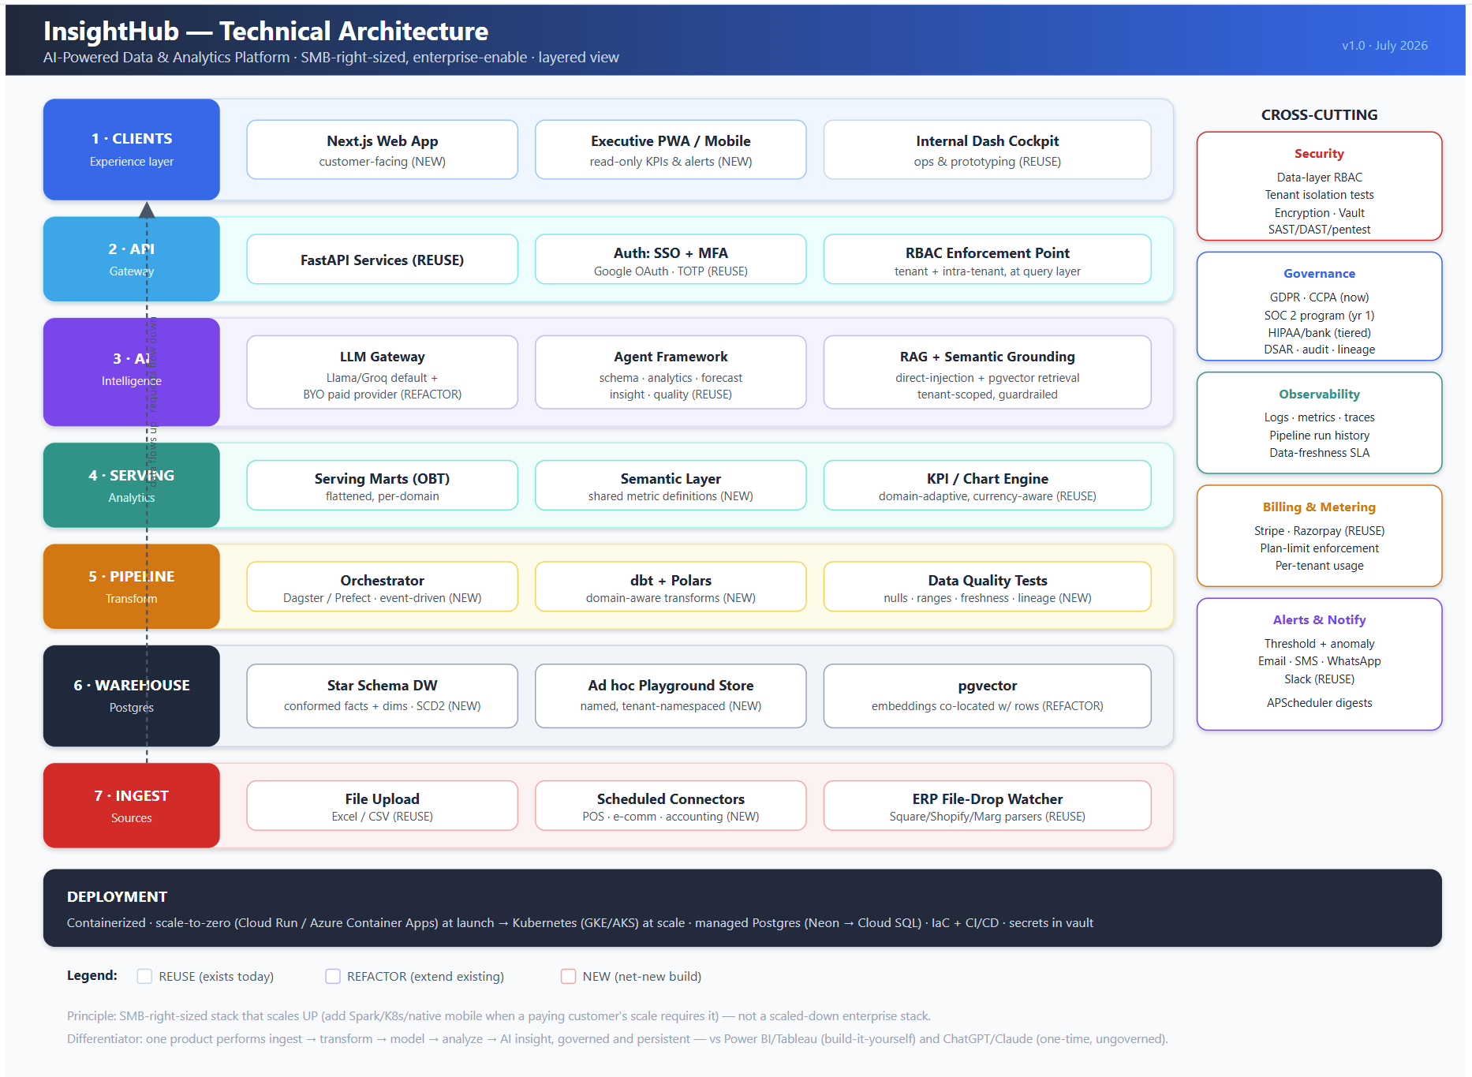

Slide 12
WHO TO SELL TO
Ideal customer & use cases
Ideal Customer Profile
High-value use cases
SMB, roughly 5–200 employees, no dedicated data/BI team
Owner/operator or ops/finance lead makes the decisions
Data lives in exports: POS, e-commerce, accounting, ERP
Already tried spreadsheets or a one-off ChatGPT analysis
Verticals with clear metrics: pharmacy, retail, SaaS, services
Values speed and simplicity over configurability
"What happened last month?" — instant monthly review
Margin & cost leakage detection across products/branches
Cash-flow visibility for owners without an accountant on staff
Anomaly watch — get pinged when sales or costs move abnormally
Multi-branch / multi-store comparison in one view
Exec mobile snapshot for leaders who never open a dashboard
InsightHub · Presales & GTM · Confidential
10
Notes:
Qualify hard on 'no data team' and 'data in exports'. Those two signals predict fast value and low churn. Lead use case is the monthly review — universal.

Slide 13
PRICING (INITIAL)
Simple, value-based tiers
Starting framework — to be refined with real usage data. Priced on outcomes and limits (users, data volume, connectors), not seats alone.
POPULAR
Starter
Growth
Scale / Enterprise
For a single owner-operator
For a growing SMB team
For multi-branch & regulated
$
$$
$$$
1 domain / workspace
Manual upload
Core analytics + AI narrative
Email alerts
1–2 users
Multi-domain + ad hoc playground
Scheduled connectors
Full AI Q&A + anomaly alerts
WhatsApp / SMS / Slack
Up to ~10 users, RBAC
Everything in Growth
BYO paid LLM + data residency
SSO, advanced RBAC, audit
SOC 2 / HIPAA posture
Priority support + SLA
Free trial / freemium entry recommended to drive self-serve activation before sales touch.
InsightHub · Presales & GTM · Confidential
11
Notes:
Don't over-commit on price numbers yet. Sell value and the Growth tier. Freemium/trial is the activation engine for SMB self-serve.

Slide 14
GO-TO-MARKET
How we reach and convert SMBs
1 · Land
2 · Prove
3 · Expand
4 · Trust
Product-led
Vertical wedges
Usage → paid
Enterprise-enable
Free trial / freemium. Self-serve upload → first insight in minutes is the activation moment. Instrument it heavily.
Pick 1–2 verticals (e.g., pharmacy, retail) where domain-tuning shines. Templated demos + case studies per vertical.
Meter usage; nudge to paid at plan limits. Land on one workspace, expand to more domains / users / connectors.
SOC 2 + RBAC + BYO-LLM unlock larger, multi-branch and regulated buyers as references accumulate.
Channels: content + SEO on 'X analytics without a data team', vertical communities, POS/accounting marketplace listings, partner referrals.
InsightHub · Presales & GTM · Confidential
12
Notes:
PLG motion: activation-first, vertical wedges to prove domain value, expand on usage, then enterprise-enable via trust. Sales team supports, doesn't gate, early on.

Slide 15
OBJECTION HANDLING
Answers to the questions you'll get
"Why not just use ChatGPT / Claude?"
"We already have Power BI / an accountant."
Great for a one-time look. But it forgets every session, has no governance, and won't alert you. InsightHub remembers, governs access, and watches your numbers 24/7.
Perfect — this doesn't replace them, it removes the setup. No developer to model data, no waiting for month-end. Insight the moment data lands.
"Is my data secure / who can see it?"
"What if my data doesn't fit your templates?"
Tenant isolation, role-based access down to the row, encryption, audit logs, GDPR/CCPA today, SOC 2 on the roadmap. Your data never trains a shared model.
The ad hoc playground analyzes any dataset you name — you still get trends, comparisons, and AI Q&A even with no matching domain.
"How accurate is the AI?"
"What does it cost to switch?"
Answers are grounded in your warehouse only, scoped to your tenant, with a shared metric layer so numbers never disagree. You can also bring your own premium LLM.
Nothing to set up — upload a file and see value in minutes. No migration project, no professional services.
InsightHub · Presales & GTM · Confidential
13
Notes:
Rehearse these until automatic. The ChatGPT objection is the most common — the answer is always persistence+governance+proactivity, never 'our AI is smarter'.

Slide 16
From spreadsheets to a governed, AI-driven habit
Recap: the whole analytics pipeline in one click — and unlike a chat window, it persists, it's governed, and it watches your numbers for you.
For prospects
For the team
For pilots
Book a 15-min demo with their own file. First insight live, in the room.
Use the 8-min script + objection cards. Qualify on 'no data team' + 'data in exports'.
Free trial, one workspace, one vertical. Measure time-to-first-insight & activation.
InsightHub — analytics for businesses with no data team.
InsightHub · Presales & GTM · Confidential
14
Notes:
Always close with a concrete next step: a demo with THEIR file. The activation metric to watch in pilots is time-to-first-insight.

